Slide 1
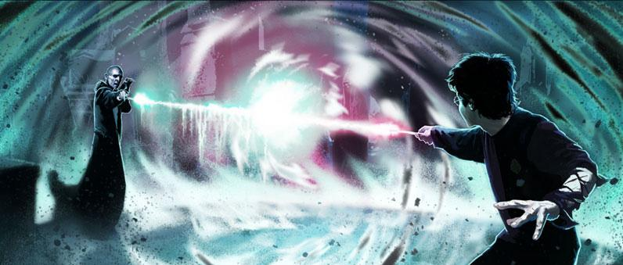
The Dueling Association
Emily Yeh & Lydia Zuehsow

Slide 2
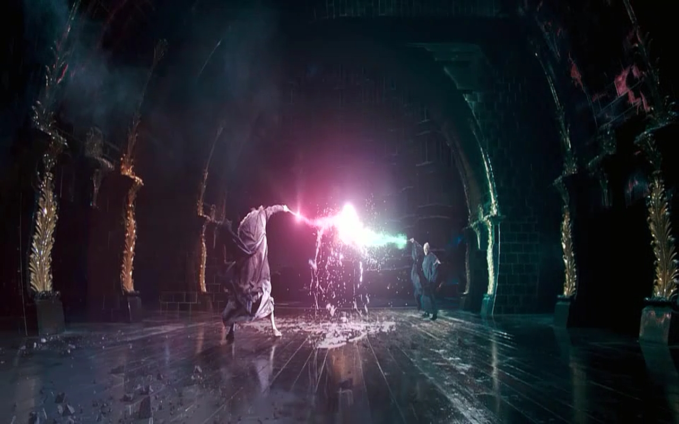
Background
We like Harry Potter!
Harry Potter duels are wizardly magical shenanigans with wands
Wizards wave a wand to cast a spell
Technically, you’re supposed to say the spell and wave a wand... but that’s okay

Slide 3
What We’ve Done So Far
We’re using OpenCV and pygame (based on Lydia’s interactive programming mini-project)
OpenCV detects a green object and pygame uses the coordinates of the green thing to draw a line
Or at least, it’s supposed to… We aren’t sure why it’s not working. Please advise? How can we use OpenCV to get coordinates that are then used in pygame to draw the exact same figure?
We’ve set up a grid that shows up on the webcam screen and on the pygame screen, and we also have a set of spells thought up
We’re using pygame.USEREVENT to track when you’re in a certain quadrant

Slide 4
Main Questions
Given that a moving object is recognized using OpenCV, how do we retrieve the object’s coordinates and use them to draw the exact same figure in pygame?
Are there more efficient ways to do this?
When a line is drawn in pygame, how do we make it trigger an action?
The screen always seems to freeze after a few seconds
Why does it do that, and how do we make it not do that?
Currently, after one of our quadrants is ‘triggered,’ it stays ‘triggered’ forever (or until a reset button is pushed)
How do we implement a time delay feature that resets quadrants that haven’t been ‘triggered’ for a long time?

Slide 5
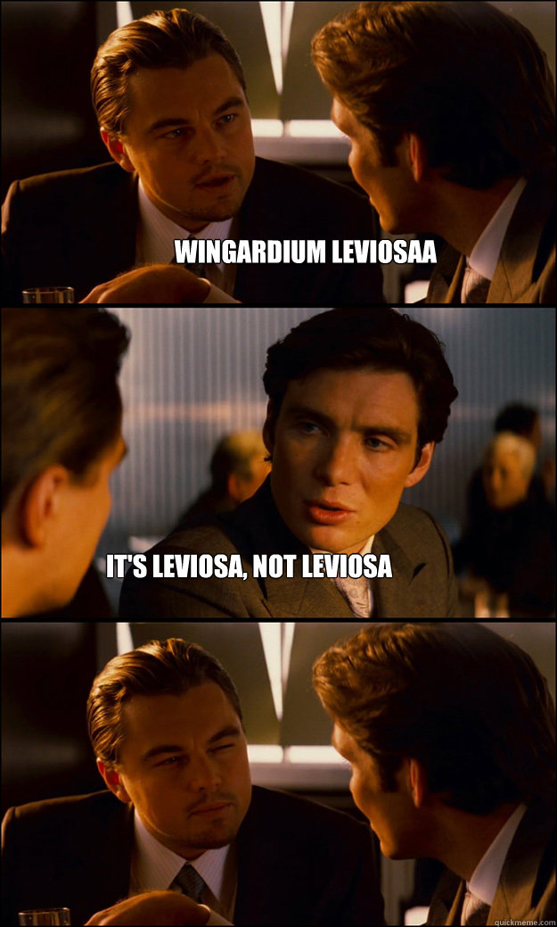
More Cool Ideas?
Help us ideate!
What would YOU want to see in a Harry Potter dueling-style game?
Bonus: Tell us how to implement these suggestions (especially if they’re complicated)
Previous suggestions:
Be able to duel over Skype/Hangouts
Some of our ideas:
Be able to play over wifi
Music/cool special effects

Slide 6
Plans for the Future
We want to create a menu and a tutorial
Wand waving is hard, man
We want to make a wand trail, to show you where your wand is/was
Create a game screen, complete with an opponent, health bars, and animations
Implement classes in our game model (Model-View-Controller) for you and your opponent
Cool graphics!

